Slide 1
Trauma and stress related disorders
Dr. Hanan Yousif Aly
Lecturer of psychiatry .
Sohag University

Slide 2
Definition of stress:
Stress is the anxious or threatened feeling that comes when interpret or appraise the situation.
(Lazarus.,1999)

Slide 3
Stressors: Events or situations in our environment that cause stress.
Environmental:
Heat, noise, crowding.
Physiological:
Drugs, caffeine, tobacco.
Emotional (psycho-social):
Pressures, life.

Slide 4
Eustress: Normal stress is necessary for an active, healthy life, increase mental and physical alertness and can enhance certain abilities .
Distress: if the stress response is excessive or prolonged, it may eventually result in diseases, such as ulcers.

Slide 5
Types of Stressors

Slide 6
Classification:
Posttraumatic stress disorder (PTSD),
Acute stress disorder, and
Adjustment disorders.

Slide 7
Post trumatic stress disorder:

Slide 8
CRITERION A: Exposure to traumatic event

Slide 9
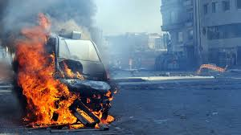
Exposure to actual of threatened death, serious injury, or sexual violence in one (or more) of the following ways:
Directly experiencing the traumatic event(s).
Witnessing,

Slide 10
Learning that the traumatic event(s) occurred to a close family member or close friend.

Slide 11
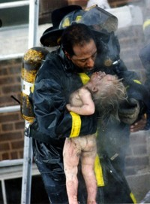
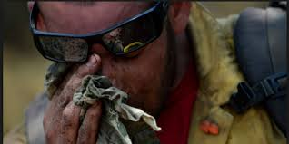
Experiencing repeated or extreme exposure to unpleasant details of the traumatic event(s)
(e.g., first responders collecting human remains;
police officers repeatedly exposed to the details of child abuse).

Slide 12
CRITERION B - Intrusion :

Slide 13
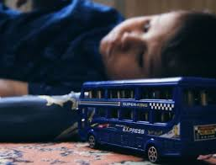
Presence of one (or more) of the following intrusion symptoms associated with the traumatic event(s), beginning after the event(s) occurred:
Recurrent, involuntary, and intrusive distressing memories of the traumatic event(s)
Note: In children older than 6 years, repetitive play may occur in which themes or aspects of the trauma are expressed.

Slide 14
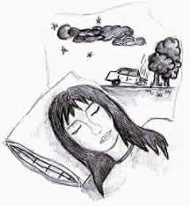
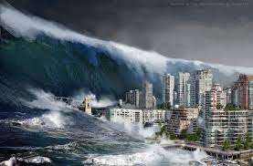
2. Recurrent distressing dreams in which the content and/or affect of the dream are related to the traumatic event.
Note: In children there may be frightening dreams without recognizable content.

Slide 15
Dissociative reactions (e.g., flashbacks) in which the individual feels or acts as if the event(s) were recurring.

Slide 16
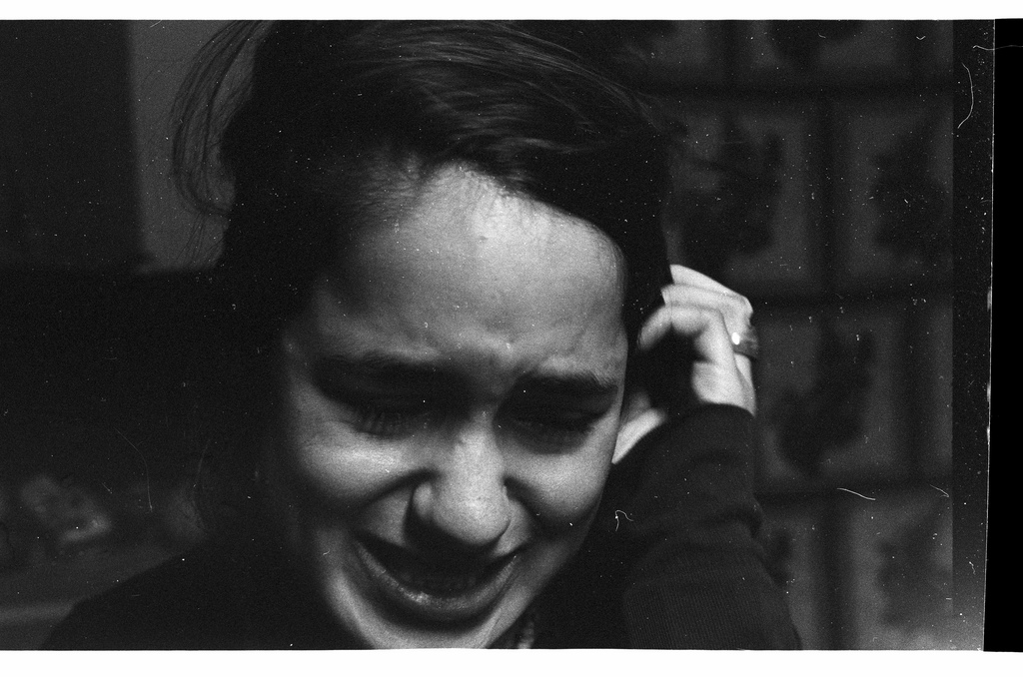
Intense or prolonged psychological distress at exposure to internal or external cues that symbolize or resemble an aspect of the traumatic event(s).
Marked physiological reaction to external or internal cues that symbolize or resemble an aspect of the traumatic event(s)

Slide 17
CRITERION C – Avoidance:
Persistent avoidance of stimuli associated with the traumatic event(s), beginning after the traumatic event(s) occurred, as evidenced by one or both of the following:

Slide 18
Avoidance of or efforts to avoid distressing memories, thoughts, or feelings about or closely associated with the traumatic event(s).

Slide 19
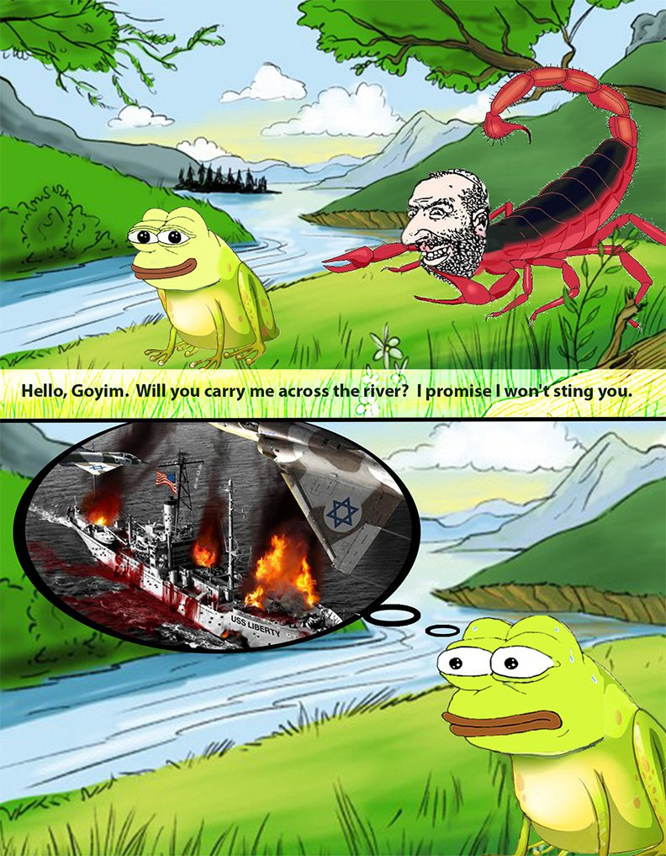
2. Avoidance of or efforts to avoid external reminders
(people, places, conversations, activities, objects, situations) that arouse distressing, memories, thoughts, or feelings about or closely associated with the traumatic event(s).

Slide 20
CRITERION D – Negative alterations in cognition & Mood.
Negative alterations in cognitions and mood associated with the traumatic event(s), beginning or worsening after the event(s) occurred, as evidenced by two or more of the following:

Slide 21
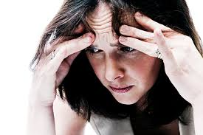
Inability to remember an important aspect of the traumatic event(s)
typically due to dissociative amnesia and
not to other factors such as head injury, alcohol or drugs.

Slide 22
2- Persistent and exaggerated negative beliefs or expectations about oneself, others, or the world (e.g.,
“I am bad,”
“No one can be trusted,”
“The world is completely dangerous,”
“My whole nervous system is permanently destroyed”).

Slide 23
3- Persistent, distorted cognitions about the cause or consequences of the traumatic event(s) that leads the individual to blame himself/herself or others.
4- Persistent negative emotional state (e.g., fear, horror, anger, guilt, or shame).

Slide 24
5- Marked diminished interest or participation in significant activities.
6- Feelings of detachment from others
7- Persistent inability to experience positive emotions (e.g., happiness, satisfaction, or loving feelings).

Slide 25
CRITERION E – Arousal & Reactivity
Marked alterations in arousal and reactivity associated with the traumatic event(s), beginning or worsening after the traumatic event(s) occurred, as evidenced by two or more of the following:

Slide 26
Irritable behavior and angry outbursts expressed as verbal or physical aggression toward people or objects.

Slide 27
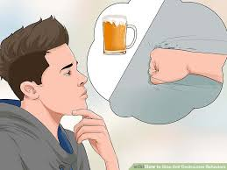
2- Reckless or self-destructive behavior.

Slide 28
3- Hypervigilance.

Slide 29
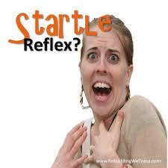
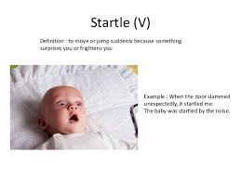
4. Exaggerated startle response.

Slide 30
5. Problems with concentration.

Slide 31
6. Sleep disturbance (e.g. problems falling or staying asleep or restless sleep).

Slide 32
Criterion B. Intrusion
Criterion C. Avoidance
Criterion D. Negative Cognitions and Mood
Criterion E. Arousal & Reactivity
Criteria A
Exposure

Slide 33
Criterion F: Duration of the disturbance (Criteria B, C, D, and E) is more than 1 month.
Criterion G: The disturbance causes clinically significant distress or impairment in social, occupational, or other important areas of functioning.
Criterion H: The disturbance is not attributable to physiological effects of a substance (e.g., medication or alcohol) or other medical condition.

Slide 34
Acute Stress Disorder
The essential feature of acute stress disorder is the development of characteristic symptoms lasting from 3 days to 1 month following exposure to one or more traumatic events

Slide 35
Adjustment Disorders
A- The development of emotional or behavioral symptoms in response to an identifiable stressor(s) occurring within 3 months of the onset of the stressor(s).

Slide 36
Adjustment Disorders
In adjustment disorders, the stressor can be of any severity rather than of the severity in PTSDs.
The stressor may be a single event (e.g., a termination of a romantic relationship),
or there may be multiple stressors (e.g., marked business difficulties and marital problems)

Slide 37
Adjustment Disorders
Stressors may be recurrent (e.g., associated with seasonal business crises, unfulfilling sexual relationships)
or continuous (e.g., a persistent painful illness with increasing disability, living in a crime-ridden neighborhood).

Slide 38
Adjustment Disorders
B. These symptoms or behaviors are clinically significant, as evidenced by one or both of the following:
Marked distress that is out of proportion to the severity or intensity of the stressor,
Significant impairment in social, occupational, or other important areas of functioning.

Slide 39
Adjustment Disorders
The stress-related disturbance does not meet the criteria for another mental disorder and is not merely an exacerbation of a preexisting mental disorder.

Slide 40
Adjustment Disorders
D. The symptoms do not represent normal bereavement.
E. Once the stressor or its consequences have terminated, the symptoms do not persist for more than an additional 6 months.

Slide 41
Adjustment Disorders
With depressed mood:
With anxiety:
With mixed anxiety and depressed mood:
With disturbance of conduct:
With mixed disturbance of emotions and conduct:
Unspecified:

